Slide 1
Getting started with data in excel
www.pwc.com

Slide 2
Class objectives
Demonstrate knowledge of data quality concepts
Demonstrate knowledge of key terms and capabilities in Excel
Demonstrate how to use Excel to acquire, transform, analyze, and visualize data
Demonstrate knowledge of leading practices for presenting findings in Excel

Slide 3
Review

Slide 4
Data analytics process
5
Present findings
1
Ask a question
4
2
Analyze data
Acquire data
3
Transform data

Slide 5
Data analysis tools
 | Examples | Access data | Transform data | Analyze data | Present findings
Spreadsheets | MS Excel LibreOffice Calc Google Sheets
Databases | MySQL Oracle MS SQL Server
Statistical programming | R Python SAS
Visual analytics | Tableau Spotfire Qlikview

Slide 6
Introduction

Slide 7

Why excel?
We have no choice… everybody uses it!
Easy-to-use
Many different functions
Advanced capabilities through add-ins
Easy to explore and manipulate the data
Can present data and analysis together
Integrated with common desktop applications
But...
Significant potential for human error
Limited scalability
Keep it simple and ask the Internet!

Slide 8
Key terms
Workbook An Excel file is referred to as a workbook
Worksheet A single “tab” or “sheet” within a Workbook
Cell The boxes within the worksheet where information is stored. Cells are referenced by column letters (A, B, C, …) and row numbers (1, 2, 3, …) like a map:
Range A contiguous set of cells referenced by the top left and bottom right cells, separated by a colon (:):
A1
BX800
EEE20
A1:D23
BA2:CT8
Notes:
Open a new Excel workbook and explain the 3 default sheets.
Then, referring to the workbook, describe each of the definitions above.
Navigate through the sheets and move the sheet position to the beginning of the workbook (click the sheet tab and drag to the correct place).
Insert a new sheet (right click a sheet tab, and click “Insert”) and change the sheet name to “New Sheet” (Right click the sheet tab and select “Rename” or double click the sheet name).
Demonstrate how they can move around the sheet, including use of shortcuts on next page.
Demonstrate zoom using the slider in the bottom right and holding Ctrl + scroll on mouse (or ‘pinching’ on the trackpad if using a PwC laptop)
Delete sheet (Right click a sheet tab, and choose “Delete”).

Slide 9
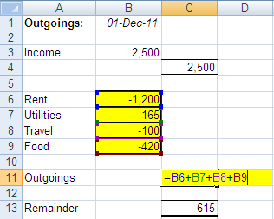
Cell references
Excel formulas can reference different cells
Changes to the referenced cells result in updates to value calculated by the formula
Cells referenced by a formula
Formula

Slide 10
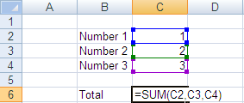
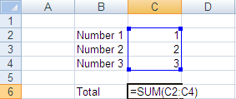
Cell references (continued)
Inputs within functions can be either a single cell reference or a block of cells referred to as a range.
The two example below provide the same result:
=SUM(C1,C2,C3) Single cells selection –
use the Ctrl Key
=SUM(C1:C3) Range selection –
use Shift Key or Drag with mouse
Note: should a row be inserted between C1 and C3, then example 1 will still provide the same results, however example two will extend to add 4 cells.

Slide 11
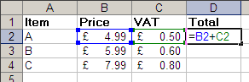
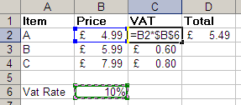
Absolute cell references
Absolute referencing is a way of referring to cells within formulas so that once copied, the cell reference remains fixed to a particular cell
Relative referencing
As a formula is copied along, the row/column numbers adjust accordingly
Absolute referencing
As a formula is copied along, it continues to refer to the same cell as before

Slide 12
Absolute cell referencing
With absolute cell referencing, a dollar sign ($) appears in the cell reference:
=B4 Refers to column B and row 4,
but this will vary if the formula is copied across a range of cells
(relative reference)
=$B4 Will always refer to column B, but row reference can vary
=B$4 Will always refer to row 4, but column reference can vary
=$B$4 Will always refer to column B and row 4
(absolute reference)
Keyboard shortcut F4 cycles through the four absolute cell reference options

Slide 13
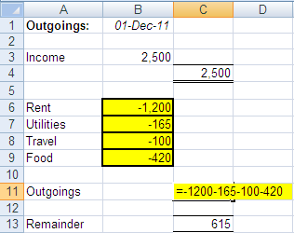
Formulas
Excel calculations are specified with formulas in each cell
To create a formula, type an equals sign (=) followed by the function and required arguments
Order of operations:
Brackets ( )
Exponent ^
Division/Multiplication / *
Addition/Subtraction + -

Slide 14
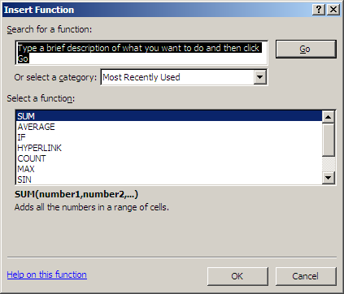
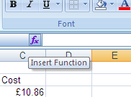
Functions
The fx button to the left of the formula bar opens a list of all available functions

Slide 15
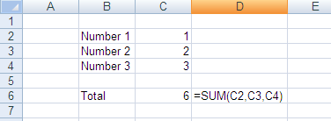
Function arguments
Functions take zero or more inputs or arguments
=FUNCTION(Input1,Input2,...)
Arguments can be:
Values 1, 2, 3 or 1.2, 3.6, 2.1 or “x”, “y”, “z” or TRUE, FALSE
Cell References B91, A452, C3
Input
Function
Output
1
2
3
SUM(1,2,3)
6

Slide 16
Navigation shortcuts (Windows)
Ctrl + ( ) navigate to last non-empty cell in that direction
Ctrl + Shift + ( ) select block of cells to last non-empty cell in that direction
Ctrl + Space select the entire column of the cell you have selected
Shift + Space select the entire row of the cell you have selected

Slide 17
Acquire data

Slide 18
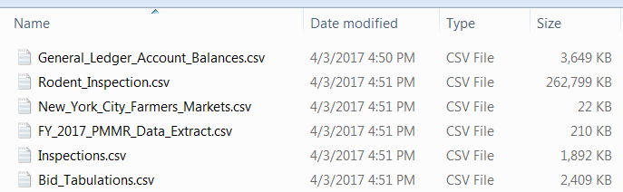
Getting data into excel
Excel files have the extension .xlsx or .xls (older versions)
Excel can also import data from delimited text files
Some comma-separated values files can be opened directly by Excel
Tab-separated values can be copy-and-pasted directly into an Excel worksheet
Delimited text can also be copy-and-pasted into Excel and then separated with text-to-columns

Slide 19
Example – Delimited text
header
DBN,SCHOOL NAME,Num of SAT Test Takers,SAT Critical Reading Avg. Score,SAT Math Avg. Score,SAT Writing Avg. Score
01M292,HENRY STREET SCHOOL FOR INTERNATIONAL STUDIES,29,355,404,363
01M448,UNIVERSITY NEIGHBORHOOD HIGH SCHOOL,91,383,423,366
01M450,EAST SIDE COMMUNITY SCHOOL,70,377,402,370
01M458,FORSYTH SATELLITE ACADEMY,7,414,401,359
01M509,MARTA VALLE HIGH SCHOOL,44,390,433,384
01M515,LOWER EAST SIDE PREPARATORY HIGH SCHOOL,112,332,557,316
01M539,"NEW EXPLORATIONS INTO SCIENCE, TECHNOLOGY AND MATH HIGH SCHOOL",159,522,574,525
01M650,CASCADES HIGH SCHOOL,18,417,418,411
01M696,BARD HIGH SCHOOL EARLY COLLEGE,130,624,604,628
02M047,47 THE AMERICAN SIGN LANGUAGE AND ENGLISH SECONDARY SCHOOL,16,395,400,387
02M288,FOOD AND FINANCE HIGH SCHOOL,62,409,393,392
02M294,ESSEX STREET ACADEMY,53,394,384,378
02M296,HIGH SCHOOL OF HOSPITALITY MANAGEMENT,58,374,375,362
02M298,PACE HIGH SCHOOL,85,423,438,432
02M300,"URBAN ASSEMBLY SCHOOL OF DESIGN AND CONSTRUCTION, THE",48,404,449,416
02M303,"FACING HISTORY SCHOOL, THE",76,353,358,340
02M305,"URBAN ASSEMBLY ACADEMY OF GOVERNMENT AND LAW, THE",50,375,388,385
02M308,LOWER MANHATTAN ARTS ACADEMY,40,403,392,405
02M313,"JAMES BALDWIN SCHOOL, THE: A SCHOOL FOR EXPEDITIONARY LEARNING",69,408,390,390
02M316,"URBAN ASSEMBLY SCHOOL OF BUSINESS FOR YOUNG WOMEN, THE",42,373,370,384
02M374,GRAMERCY ARTS HIGH SCHOOL,60,391,391,394
02M376,NYC ISCHOOL,92,473,483,479
delimiter
text qualifier

Slide 20
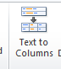
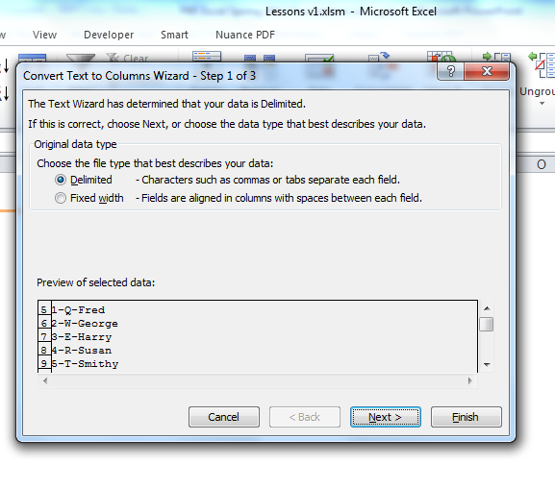
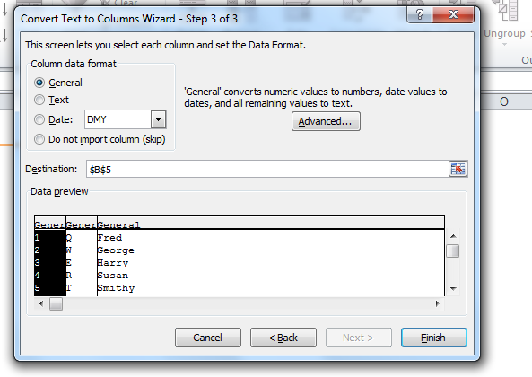
Text to columns
You might have text in one column that should be split across multiple columns, such as “1-Q-Fred” in the example below
You can use the “Text to Columns” wizard to accomplish this
Notes:
Using the sheet, explain the difference between “Delimited” and Fixed Width.
Use the Text to Columns to turn the text into columns. Take them through the process, including section on Destination.
Follow the steps prompted when clicking the icon in the Data tab. You can specify:
Whether the separation point is defined by a certain character (Delimited) or at a fixed point in the cell (Fixed Width).
What character separates the information
Where you would like the newly separated information to go.

Slide 21
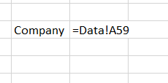
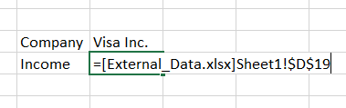
References to worksheets and workbooks
You can also use data from other worksheets or other workbooks in your formulas
Another worksheet in the same workbook is represented by “Sheet!”
A worksheet in a different workbook is represented by “[Workbook.xlsx]Sheet!”

Slide 22
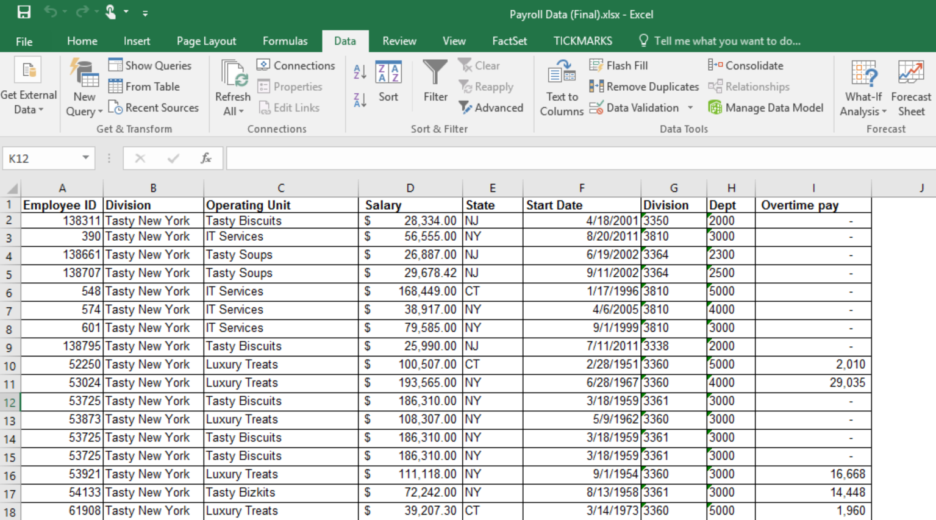
Sample spreadsheet

Slide 23
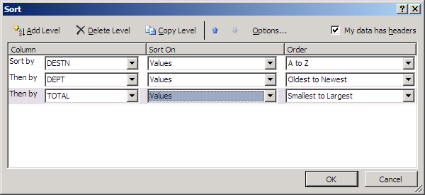
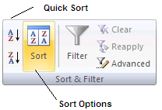
Sorting
Highlight a range and use the Sort option to order records by one or more columns
Make sure to select an entire table to avoid sorting only part of it

Slide 24
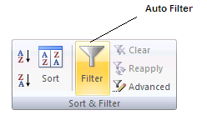
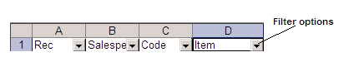
Filters
Filtering allows you to hide rows in a range if they don’t match select criteria
Highlight the range and click the “Filter” button
Salary >
10k
Location
= NY

Slide 25
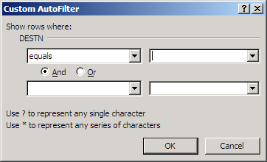
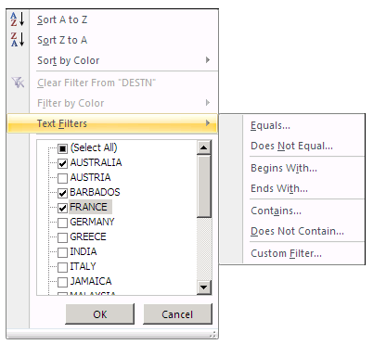
Custom filters
Custom filters allow you to use multiple criteria such as AND or OR
Click on drop down arrow
Click “Text Filters”
Choose Custom
Location
=
Australia
Location =
France
OR

Slide 26
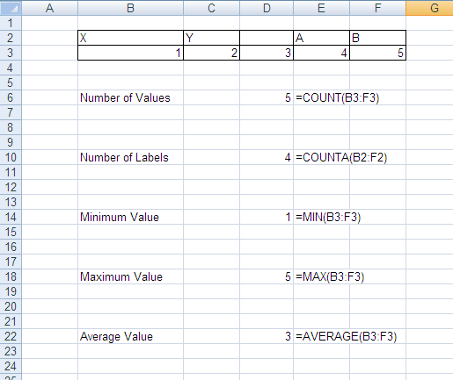
Summary statistics
COUNT()
Counts numbers
COUNTBLANK()
Counts empty cells
COUNTA()
Counts non-empty cells
MIN()
Returns minimum
MAX()
Returns maximum
AVERAGE()
Returns average/mean
ROWS/COLUMNS()
Return number of rows/columns

Slide 27
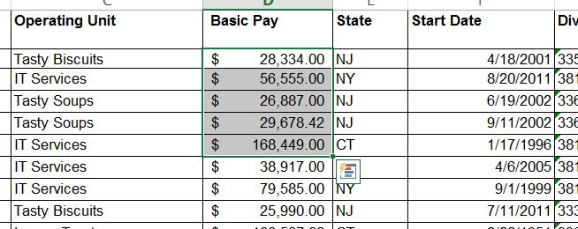
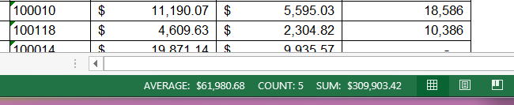
Status bar
Highlighting a range of cells returns summary statistics on the status bar in the lower right corner
This is a quick way to get information about part of your data

Slide 28
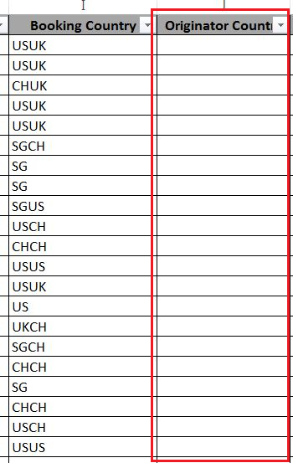
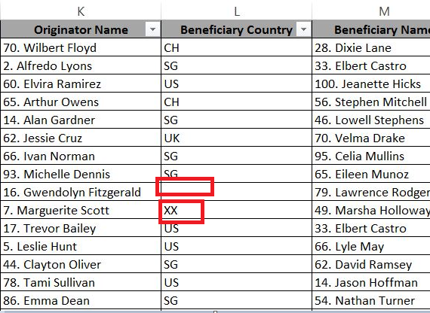
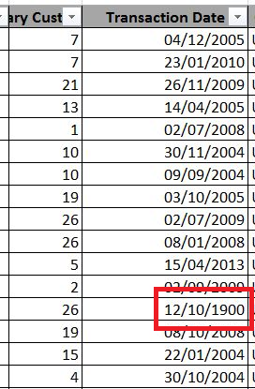
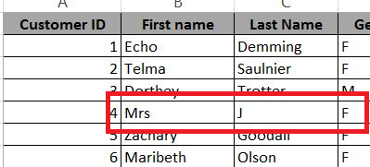
Can we rely on the data?
Why does ‘Booking Country’ have two country codes while ‘Originator Country’ is blank ?
Does ‘Beneficiary Country’ have a valid country code ?
Does this look like a valid transaction date?
Does this look like a valid customer name?

Slide 29
Data quality dimensions
Completeness
Is any key information missing or are there null values?
Timeliness
Is the information
update frequency adequate to
meet business requirements?
Validity
Do values adhere to defined business rules, accepted values and
accepted formats?
Integrity
Do broken links exist between data that should be related?
Accuracy
Is data accurate when compared to the source or original content?
Consistency
Is the data value
consistent between different systems? Do duplicate records
exist?

Slide 30
Exercise – Data quality dimensions
Identify which of the six DQ dimensions applies to the issues described below:
‘Gender’ field has the special characters like ~!@#$%^*();
‘First name’ is blank or Null
‘Last name’ field has only designators such as LLP, LLC, Mr., Mrs., etc
‘Address’ field has only numbers
‘Account Type’ field does not have pre-defined list of values
‘Account Number’ field have duplicate values
‘Forex rate’ field does not have up to date exchange rate
Notes:
Validity
Completeness
Accuracy
Validity
Consistency
Integrity
Timeliness

Slide 31
Exercise – Excel #1
Load the data from ‘payroll_data.txt’ and ‘reference_data.txt’ into two tabs in an Excel spreadsheet and save it as ‘Payroll Data_<NETID>.xlsx’:
How did you import the data?
How many rows are there?
How many columns?
What is the average salary?
How many missing values are in each column?
What potential data quality issues do you find? Which dimensions are they related to?

Slide 32
Transform data

Slide 33
Data formats
Data entered an Excel worksheet can be represented in different formats, for example:
Number
Currency
Percentage
Text
Date
Dates are stored as the number of days from a fixed historical date

Slide 34
Text functions
=CONCATENATE (text1, text2, …) or &
Appends two or more strings
=MID(text, start_num, num_chars)
Extracts a specific number of characters starting from a given position
=LEFT(text, num_chars)
Extracts a specific number of characters from the left of a cell
=RIGHT(text, num_chars)
Extracts a specific number of characters from the right of a cell
=LEN(text)
Return the number of characters (including spaces) in a cell
=SUBSTITUTE(text, old_text, new_text)
Replaces a string with another string
=FIND(find_text, within_text, start_position)
Return the position of a match and error if no match
Notes:
On a blank sheet type in your full name ( including your middle name and title) e.g. Miss Sian Megan Houdmont
Demonstrate the mid, left, right, len functions by extracting text from the names
Open the worksheet, and Demonstrate the mid, left, right, len functions by extracting text from the names

Slide 35
Number functions
=ROUND(number, num_digits)
Rounds a figure to a specified number of digits
=LARGE(array, k)
Returns the kth largest number
=SMALL(array, k)
Returns the kth smallest number
=PRODUCT(number1, number2, …)
Multiplies several values together
=EXP(number)
Returns Euler’s number (e) raised to a number
=RAND()
Returns a random number between 0 and 1
=RANDBETWEEN(bottom, top)
Returns a random integer between the specified values
Notes:
You may not want to teach these, but if you do, use a number of separate cells to break up the calculations.

Slide 36
Date/time functions
=TODAY()
=NOW()
=DATE(year, month, day)
=DAY(serial_number)
=MONTH(serial_number)
=YEAR(serial_number)
=WEEKNUM(serial_number)
=WEEKDAY(serial_number)
=DAYS(end_date, start_date)
Returns number of days between two dates
=NETWORKDAYS(start_date, end_date)
Returns the number of working days between dates
Displays current date
Displays current date and time
Generates a date given day, month, and year
Determines day of date, e.g. 31
Determines month of date, e.g. 12
Determines year of date, e.g. 2001
Returns the week number in the year
Returns the position of the day in a workweek
Notes:
Demonstrate the use of these functions on a blank sheet
Difference between now and today as number (decimals)
Then use file

Slide 37
Fill
You can apply a formula to an entire column by using the Fill options
You can also Fill Down by double-clicking a cell with a formula in a table

Slide 38
Error trapping
=ISNA(value)
Determine if cell or result of formula is showing #N/A!
=ISERROR(value)
Determine if cell or result of formula is an error
=IFERROR(value, value_if_error)
Give an alternative result if the formula produces an error
Notes:
Outline some of the uses for the functions above:
Error checking
User-friendly outputs
Use file to determine if this person is sales staff, return Y or N (use =Search)
Use function IF and ISERROR as IFERROR will not allow 2 different result
Explain leading practice that we error trap for errors we expect (ie to prevent #n/a errors on a match formula, use isna rather than iferror) so that unexpected errors get seen and resolved

Slide 39
IF statements
IF() analyses the contents of one or more cells to determine whether a condition is TRUE or FALSE
Given the value of the condition, different values can be returned
Syntax
=IF ( logical_test , value_if_true , value_if_false )
Examples
=IF ( B1 > 50 , B1 * $A$1, B1 * $A$3)
=IF ( B1 > B2 , B1 , B2 )
=IF ( B1 = “Male” , B1 , B2 )
Salary more than $50k?
TRUE
FALSE
Salary multiplied by $A$1
Salary multiplied by $A$3
Notes:
Introduce the concept of basic IF functions
Do a simple table exercise with their names and genders, and then If to determine Mr or Ms
DEMONSTRATION:
Fill in the Bonus Columns in Statement 1
Use range names and absolute references to enhance the exercise
Fill in VAT Column in IF Statement 2
Any type of data, number, text, formula

Slide 40
Conditional operators
Any function can be used with conditional operators in IF statements to test conditions
> Greater than
< Less than
>= Greater than and equal to
<= Less than and equal to
<> Not equal to
= Equal to
Notes:
Run through a brief description of these operators, stress that some of them can be used only on numbers, some to dates and some to strings.
Addition: Numbers, Dates
Subtraction: Numbers, Dates
Multiplication: Numbers
Division: Numbers
Power: Numbers
(): Anything
Order operators (>,< etc.) : Numbers, Dates, Strings
Concatenation: Anything

Slide 41
Nested conditional statements
=IF (logical_test , value_if_true , IF (logical_test , value_if_true , value_if_false ))
Salary more than $50k?
true
false
Salary multiplied by 22%
Salary more than $150k
true
false
Salary multiplied by 30%
Salary multiplied by 40%
=IF ( B1 > 50 , B1 * $A$1, IF ( B1 > 150 , B1 * $A$2, B1 * $A$3) )

Slide 42
Logical operators
=AND(logical1, logical2, …) Gives True if all the conditions are met
=OR(logical1, logical2, …) Gives True if at least one condition is met
=NOT(logical) Gives True if the condition is not met
=IF(AND(B2="Global",C2="Executive"),"Yes","No")
=IF(OR(C2="Consultant",C2="Director"),"Yes","No")
=IF(NOT(A2=$G$27),"Yes","No")
Notes:
Use file using OR instead of nested IF Statement

Slide 43
VLOOKUP
Often we need to add data from one table to another
This requires one column in each table to act as the link between them
VLOOKUP searches vertically down the left-hand column of a table to find a match, then returns the corresponding value from a specified column of the table
In most cases, the fourth argument should be ‘FALSE’ to require exact matches
Always use absolute cell references to specify the range containing the lookup data
Syntax
=VLOOKUP( lookup_value, table_array,
col_index_num, range_lookup)
Example
=VLOOKUP(“Grade 5”, $A$2:$B$6, 2, FALSE)
...returns a value of 46000, because this is the value in column 2 of the table alongside “Grade 5”
Notes:
Use file
Create sample with salaries as per slide
Point at the screen and talk them through exactly what this algorithm is doing.
Like a bank – your bank uses your ID number to bring back all your other data
Things to remember
- lookup data must be in col 1
- breaks if you insert extra columns
-
- must be in ascending order
When dealing with order - ‘has met my minimum’
Modellers consider it better practice to use INDEX/MATCH, but VLOOKUP is quick and simple, and you often encounter it in other people’s spreadsheets so it’s worth understanding it.
Can force it to not guess – look up 65,500 – issue because it’s not sorted

Slide 44
Unique values and duplicates
Excel has an option to reduce a single column to its unique values
This option can also remove duplicate rows from a table across multiple columns
Notes:
Using the Sheet, Create a list of unique animals

Slide 45
Find/Replace
You may need to find or replace values across a worksheet or workbook, which would be time-consuming if done manually
Use Find/Replace to do this efficiently:
Ctrl + F: find
Ctrl + H: replace
Excel will search the whole worksheet (or workbook) unless a range is selected
The “Options >>” button enables the use of requirements such as “Match case”
Notes:
Using the Sheet, first demonstrate find
Then Replace all occurences of “Horse” with “Sheep”
Find and replace is a simple tool used to quickly replace a value that reoccurs throughout the sheet or workbook.
On any sheet just hold Ctrl + H
You can use the options to include
more variables such as case,
formatting and the search area.

Slide 46
Exercise #2
In ‘Payroll Data_<NETID>.xlsx’:
Address any data quality issues identified previously.
Create a new column with total compensation (salary plus overtime pay)… what is the average total compensation?
Add a column for the employee’s tenure at the company in years.
It turns out that all of the NJ employees work for separate division called “Tasty New Jersey”. Correct the Division column with this information.
Create a binary column (0/1) that identifies employees of the “Tasty” operating units.
Add columns for Job Position and Gender from the ‘Reference Data’ worksheet.
Select a random 5% sample of employees to receive a survey.

Slide 47
Analyze data

Slide 48
Pivot tables
A pivot table is an aggregation of a source table
Supports summary statistics:
Count
Sum
Min/Max
Average
This summary is presented in a table format which can be formatted and filtered
A table with categories down the rows and across the columns is a cross table
Sum of Sales | Month
Salesperson | Jan | Feb | Mar | Grand Total
Bert | 7508 | 10360 | 6281 | 24149
Bill | 5113 | 8916 | 7642 | 21671
Fred | 7561 | 9735 | 11221 | 28517
Harry | 10513 | 3583 | 9452 | 23548
Grand Total | 30695 | 32594 | 34596 | 97885

Slide 49
Customizing pivot tables
Filters
Change total sample
Columns
Rows
Can stack multiple fields, e.g. site broken down by team
Options
Details of the way fields are displayed in the table are changed here
Cells: A variable summarised by rows/columns/filters
Notes:
Recreate this template in the demonstration file and demonstrate how it is constructed – avoid changing summary functions etc till next slide.
Place Status in ‘Report Filters’
Place Cost Centre in ‘Column Labels’
Place Site and Team in ‘Row Labels’
Place Salary in ‘Values
Move through option by option on the context sensitive menu

Slide 50
Customizing pivot tables
Rows and Columns can have subtotals added to them, names changed, and additional options applied to the layout.
Value Fields/Cells can be summarised by different functions and shown as various values
Notes:
Demonstrate changing some of the field settings for both a row/column and a cell.
Add Column Subtotals
Check ‘Show items with no label’ in Column Settings -> Layout & Print
Change value summary functions to average of Salary
Show Salary values as Percentage of Row

Slide 51
Analysis ToolPak
Excel can be used for more advanced analysis than summary statistics and charts
Click the File tab, click Options, and then click the Add-Ins category
In the Manage box, select Excel Add-ins and then click ‘Go’
In the Add-Ins box, check the ‘Analysis ToolPak’ and ‘Solver’ check boxes, and then click ‘OK’
Go to the ‘Data’ tab and look for the Analysis section

Slide 52
Descriptive statistics
Instead of using individual functions, the ‘Data analysis’ tab enables the user to calculate various statistics for a column at the same time

Slide 53
Histograms
A histogram depicts the frequency or probability distribution of a numeric variable across bins of equal width
Variable distributions may appear statistically “normal” or display non-normal characteristics such as skewness or kurtosis
Create a histogram through ‘Data analysis’ by specifying the bins in a separate range

Slide 54
Correlation
The CORREL() function (and Data Analysis correlation option) quantify the direction and degree of the relationship between two variables
Correlation coefficient is between -1 and 1:
Negative values indicate the variables are inversely related
Positive values indicate the variables are directly related
Values close to zero indicate a weak correlation
Values close to 1 indicate a strong correlation
Correlation is often best visualized with a scatter plot

Slide 55
Linear regression (univariate)
In addition to descriptive statistics, Excel can build and evaluate simple predictive models:
Select ‘Regression’ from the Data Analysis section
Select your dependent (Y) variable (to be predicted)
Select your independent (X) variable (used to predict the Y variable)
Check boxes for optional outputs (e.g. residuals, line fit plot)

Slide 56
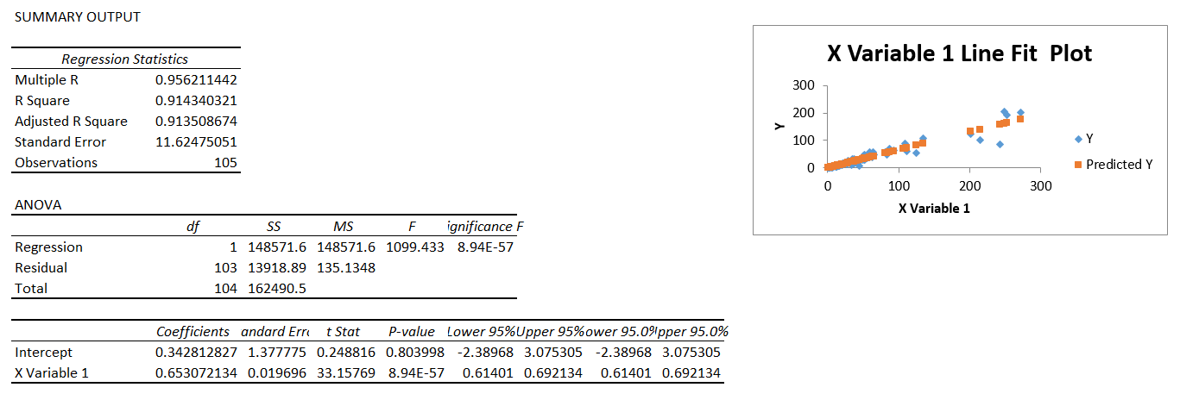
Linear regression output
Actual values
Goodness of fit
Predicted values
Coefficient and intercept

Slide 57
Exercise #3
In ‘Payroll Data_<NETID>.xlsx’:
What is the average percentage of total compensation that is overtime pay, not including staff with no overtime pay?
Create a pivot table with the following statistics by Operating Unit:
Number of employees
Average total compensation
Average tenure (in years)
Add Job Title to the pivot table across the columns
What is the correlation between total compensation and tenure?
Create a histogram for total compensation… how would you characterize the distribution? What if you transform the data to reduce any skewness?
Create a linear regression model using tenure to predict total compensation… what is the adjusted R-squared value?

Slide 58
Present findings

Slide 59
Exercise – Four data sets
1
2
3
4
X1 | Y1
10 | 8.04
8 | 6.95
13 | 7.58
9 | 8.81
11 | 8.33
14 | 9.96
6 | 7.24
4 | 4.26
12 | 10.84
7 | 4.82
5 | 5.68
X2 | Y2
10 | 9.14
8 | 8.14
13 | 8.74
9 | 8.77
11 | 9.26
14 | 8.1
6 | 6.13
4 | 3.1
12 | 9.13
7 | 7.26
5 | 4.74
X3 | Y3
10 | 7.46
8 | 6.77
13 | 12.74
9 | 7.11
11 | 7.81
14 | 8.84
6 | 6.08
4 | 5.39
12 | 8.15
7 | 6.42
5 | 5.73
X4 | Y4
8 | 6.58
8 | 5.76
8 | 7.71
8 | 8.84
8 | 8.47
8 | 7.04
8 | 5.25
19 | 12.5
8 | 5.56
8 | 7.91
8 | 6.89
Open the file ‘Four Data Sets.xlsx’
For each of the four data sets, calculate the average of X and Y.
What do you notice? What else?
Copy your final results into a new tab in ‘Payroll Data_<NETID>.xlsx’

Slide 60
Visualisation in excel
Visualization is often essential for gaining an understanding of the data and presenting findings to a new audience
Excel can easily produce a variety of basic charts
For an effective visualization, always consider:
What question do I want to answer?
What message do I want my audience to take away?
How can I keep it simple?
We’ll focus more on visualization later in the course
Notes:
This is the super super quick version of the visualising information course

Slide 61
Conditional formatting
Conditional formatting adjusts the color of a cell according to the relative magnitude of the values or established rules
It is commonly used for RAG (Red/Amber/Green) reports, in which good figures are highlighted in green and bad ones in red, but any gradient can be applied

Slide 62
What do you think of this visualization?
Notes:
Before adding the title – ask what the message is this time?
Cleared out the junk, showed who we want to talk about, and shown that manchester is at the bottom of the list

Slide 63
What about this one?
Manchester University has low teaching score compared to its competitors
Notes:
Before adding the title – ask what the message is this time?
Cleared out the junk, showed who we want to talk about, and shown that manchester is at the bottom of the list

Slide 64
Effective visualisation
More information, less ink
Clear out the junk!
Use color, shape, placement, etc. to draw attention
Use 2D rather than 3D charts
Notes:
Re-cap
Don’t use pie charts – very difficult to interpret visually – talk about this afterwards...

Slide 65

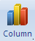
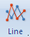
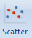
Basic charts
Type of chart | When to use them | Examples
Bar/Column | Discrete values | Number of employees at different offices
Line | Continuous values, over time | Annual revenue
Scatter | Continuous values, two variables | Quantity and price for different products
Notes:
Discrete variables are where the different items are not related to one another
Continuous variables have a progression between them – this is mostly to do with time series, but could also be distance

Slide 66
Insert chart
The first step to setting up your chart is to arrange the data into a table
Then select the table and select the type of graph you are looking for on the Insert tab

Slide 67
Axis settings

Slide 68
Data labels
Notes:
Point out that you can have axes AND data labels if you want, but generally for the sake of simplicity you’d have only one or the other.

Slide 69
Gridlines
Notes:
Are the gridlines helpful in this case or are they unnecessary clutter? Invite comments

Slide 70
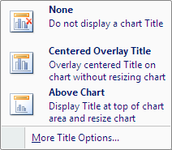
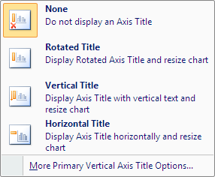
Titles
Notes:
Which of these titles ‘add value’ to the graph and which are unnecessary? Invite comments
(The title “Growth of ABC company” is useful, but the two axis titles are probably redundant because it’s obvious what these axes show.)

Slide 71
Data in rows or columns

Slide 72
Changing data range
Sometimes we want to change the data range covered by a chart or add an extra series
When you select a data series on a chart, the source data range can be adjusted
Notes:
Explain what is happening here – the data range is being expanded so that the 2006 figures are included on the chart.
If you wish to demonstrate this live in Excel, you can do so using Chart demo
It is also worth demo’ing that you can drag the cells size too.

Slide 73
Select data source
You can also use the Select Data Source dialog box from the Design tab in the ribbon or by right-clicking the chart to add a new series to a graph
Notes:
If you wish to demonstrate this live in Excel, you can do so using Chart demo.xlsx
This also allows you to add and remove series that you are not interested in.
Now clear the chart, and make it again only for revenue. Then goto to select data source, and add profit as a new series.

Slide 74
Pivot charts
In addition to creating a Pivot table on the data, you can also create a Pivot Chart which is based on the Pivot table itself
Changes made to the chart are replicated on the table and vice versa
Notes:
Create a basic pivot chart of the same data and place Cost Centre in Rows, Grade in Columns and Sum of FTE in values

Slide 75
Exercise #4
In ‘Payroll Data_<NETID>.xlsx’:
Create a pivot table with average salary by Operating Unit and State and add conditional formatting.
Create a bar plot with the number of employees by State
Create a scatter plot of salary and tenure
Create a line chart to show the cumulative number of employees hired by year.

Slide 76
Preparing a final workbook
Getting an Excel file into a presentable state can be a challenge
Storyboard your workbook and consider how someone would “read” through it
Keep it simple!
The following approaches can help with the finishing touches:
Formula auditing
Page layout
Freeze panes
Validation
Removing gridlines

Slide 77
Formula auditing
To check that formulas have the right cell references, use Trace Precedents or Trace Dependents to display an arrow between linked cells

Slide 78
Removing gridlines
One quick tip for making a workbook look instantly less cluttered is to remove the gridlines

Slide 79
Freeze panes
As worksheets can get very large, it is important to ensure that the data being viewed on screen at all points has titles and comments representing the appropriate columns
Freeze panes allows for parts of the Excel document to be frozen, useful to preserve titles and headings
Freeze Panes freezes all rows above the selected cell and all columns to the left of the selected cell
Other variations are Freeze Top Row and Freeze First Column

Slide 80
Page layout
To ensure that the worksheet prints neatly, you may need to change settings on the Page Layout tab:
Changing the page orientation (Portrait vs Landscape)
Adjusting the margins
Specifying a print area (the part of the worksheet that will be printed)
Setting up page breaks at particular points
Use Print Preview to check how your worksheet will look when printed

Slide 81
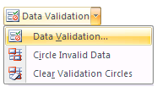
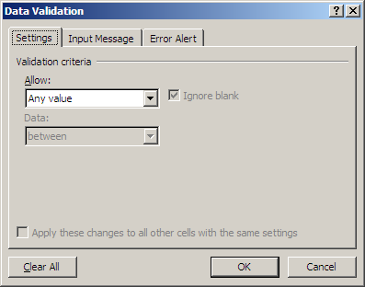
Data validation
Data validation controls what type of data a user can input into a cell, for example:
Only a number within a certain range
Only a time/date within a certain period
Only an item from a predefined list
Notes:
Explain what it is
How it is used and why
Advantages and Disadvantages
Demonstrate Input Box and Error Alert
10mins
Use ‘Lessons’, refer to worksheet

Slide 82
More leading practices
Save your workbook with A1 as the active cell
Put a title and description for the workbook in the upper left corner of the first sheet
Name your spreadsheet tabs so users can easily navigate throughout your workbook
Don’t hide columns or rows; instead, group them
Consider if hardcoded parameters make sense or should be avoided
Be careful with merged cells
Keep source data in the workbook
Break down complicated formulas

Slide 83
Summary

Slide 84
Acquire data
Task | Description | Excel
Data access | Connect to a data source | File > Open Open in text editor and copy/paste
Importing data | Read the data into an analytical environment | Text Import Wizard Data > Text to Columns
Data profiling | Review data dimensions and summary statistics | COUNT() MIN(), MAX(), etc.
Data quality assessment | Identify aspects of the data that pose challenges for subsequent analysis | Sort Filter COUNTBLANK()
Data simulation | Generate data based on analytical requirements | RAND() RANDBETWEEN() CHOOSE()

Slide 85
Transform data
Task | Description | Excel
Cleaning data | Address data quality issues to facilitate analysis | Find/Replace
Changing data types | Convert a value to the appropriate format for analysis | Format
Filtering data | Create subsets of records and features based on specified conditions | Filter IF()
Deriving data | Create new features from original features | MID() FIND() LEN() ROUND() WEEKDAY() …
Scaling data | Put features with different ranges of values on the same scale while preserving relative values | SUM() AVERAGE() EXP()
Notes:
Data wrangling, munging, preparation…

Slide 86
Transform data
Task | Description | Excel
Sampling data | Create subsets of records based on a probability distribution | RAND() RANDBETWEEN()
Aggregating data | Return a statistic or value for one feature according to different values of another feature | Pivot Table
Reshaping data | Change whether values are represented in different records or different features | Pivot Table
Concatenating data | Combine data sets through juxtaposition | Cut and paste
Merging data | Combine data sets by matching records on a common identifier | VLOOKUP() HLOOKUP() INDEX()/MATCH()
Notes:
Data wrangling, munging, preparation…

Slide 87
Analyze data
Task | Description | Excel
Summary analysis | Calculate representative statistics for features of interest | AVERAGE() MEDIAN() PERCENTILE.INC()
Perform statistical tests | Estimate the probability that the data supports a specific claim | Data Analysis Toolpak
Clustering | Identify similar groups of records
Predictive modeling | Use one set of features to predict the value of another feature | Data Analysis Toolpak
Network analysis

Slide 88
Present findings
Task | Description | Excel
Data visualization | Display data using lines, shapes, colors, and other abstract representations | Charts
Dashboarding | Create a collection of dynamic visualizations | Charts
Exporting data | Produce output from an analytical environment for future use | File > Save As
Make recommendations | Use results of data analysis to guide decision-making

Slide 89
Appendix

Slide 90
“Anscombe’s quartet”
Property | Value | Accuracy
Mean of x | 9 | exact
Sample variance of x | 11 | exact
Mean of y | 7.5 | 2 decimal places
Sample variance of y | 4.125 | plus/minus 0.003
Correlation between x and y | 0.816 | 3 decimal places
Linear regression line | y = 3.00 + 0.500x | 2-3 decimal places

Slide 91
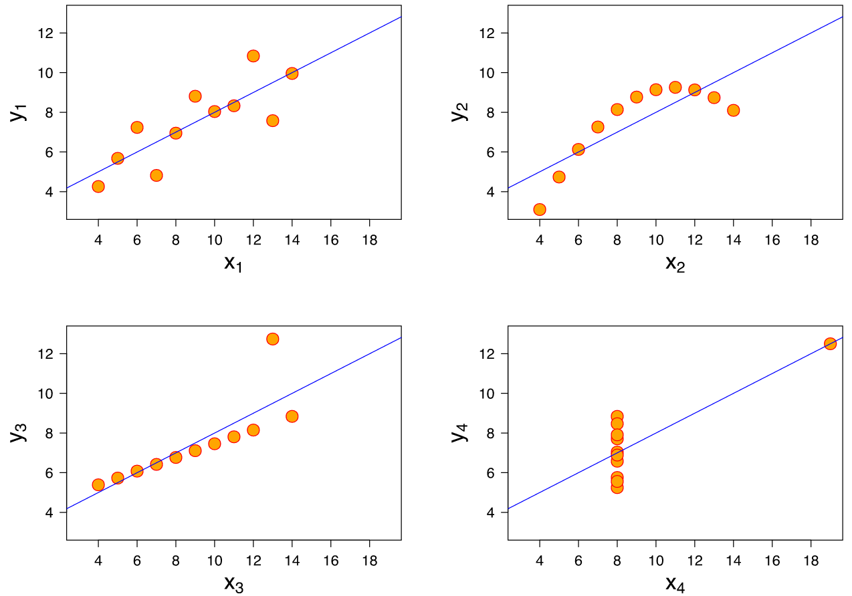
Visualizing the quartet

Slide 92
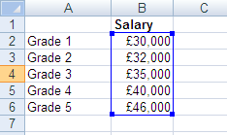
Index function
An alternative approach that offers greater flexibility is to use a combination of the INDEX and MATCH functions.
INDEX returns the value at a particular position (index) in a range
Syntax
=INDEX ( range of values, row number, column number (optional) )
Example
=INDEX (B2:B6, 4)
Returns a value of 40000, because 40000 is in the fourth row of the range.
Notes:
Point at the screen and talk them through exactly what this algorithm is doing.
It is worth performing this example with a number or the Match in a separate cell before merging them into one.

Slide 93
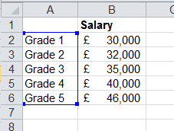
Match
MATCH is used to find which row or column in a list contains a particular value
Typically the match type should be set to zero for an exact match
Syntax
=MATCH ( value to find, range to search, match type (optional) )
Example
=MATCH (“Grade 3”, A2:A6, 0)
Returns a value of 3, because ‘Grade 3’ is in the third cell of the range
Notes:
Point at the screen and talk them through exactly what this algorithm is doing.

Slide 94
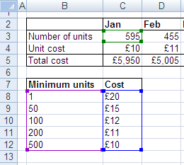
Index/Match
Example: Find the unit cost based on the number of units
First we use a MATCH function to find the appropriate row based on the (approximate) number of units:
=MATCH(C3,$B$8:$B$12,1)
Then we use an INDEX function to retrieve the cost value contained in this row:
=INDEX($C$8:$C$12, row number goes here )
These combine to make an overall formula:
=INDEX($C$8:$C$12,MATCH(C3,$B$8:$B$12,1))
In this example, the number of units is 595, and the formula returns $10.
Formula goes into this cell (C4) and can be copied along the row.
Notes:
Use file
Point at the screen and talk them through exactly what this algorithm is doing.
Ask what the MATCH function would return in this example (answer: 5), and make sure delegates understand what the argument 1 is for (Less Than).
DEMONSTRATION: demonstrate this in practice as described on the slide

Slide 95
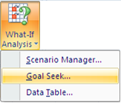
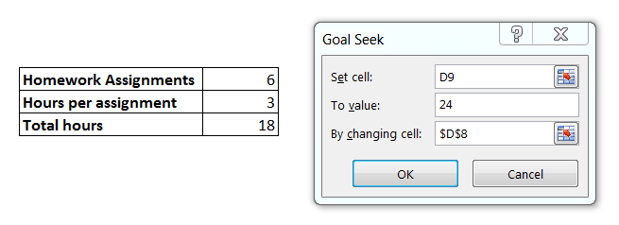
Optimization
Goalseek provides a way to solve simple equations
Set a cell to a value
Change another cell to produce the set value
Solver provides more powerful and scalable optimization for systems of equations

Slide 96
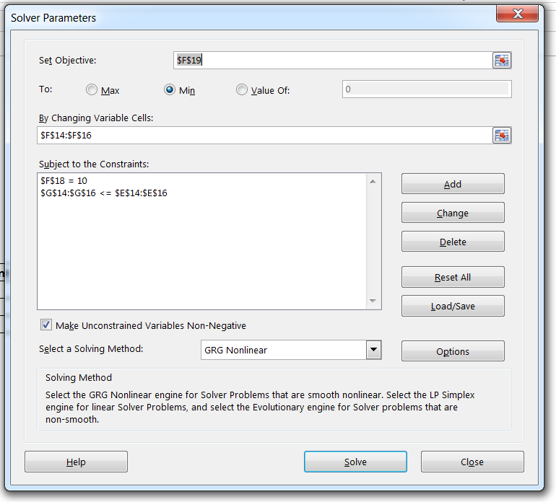
Solver – Objective and constraints
Number of questions must be equal to X
Students want to minimize the time it takes to complete the assignment
Students can’t work more than they are available
Limit to integer solutions

Slide 97
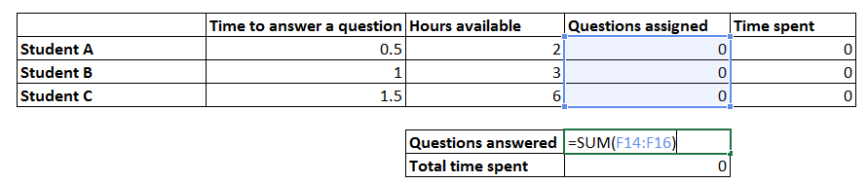
Exercise – Optimization
Open the file ‘Team Assignments.xlsx’
A team of three students has to complete a homework assignment by answering a series of questions. The students work at different paces, and they have limited availability due to other commitments. How should they distribute the work to spend the least amount of time collectively if the assignment has 10 questions? 8 questions? 15 questions?
Copy your final results into a new tab in ‘Payroll Data_<NETID>.xlsx’

Slide 98
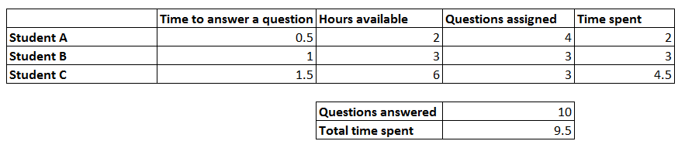
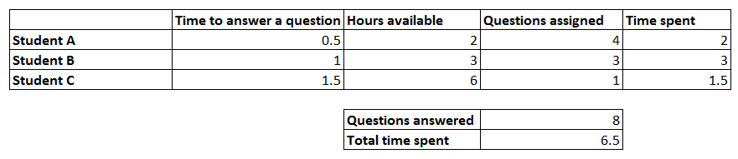
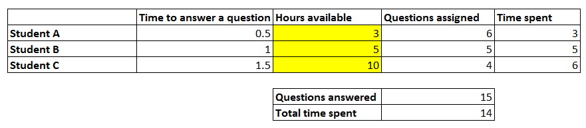
Solving the optimization problem
Have to find more time to answer 15 questions!

Slide 99
© 2018 PwC. All rights reserved. PwC refers to the US member firm or one of its subsidiaries or affiliates, and may sometimes refer to the PwC network. Each member firm is a separate legal entity. Please see www.pwc.com/structure for further details.

